Slide 1
Distances to Globular Clusters using RR Lyrae Variable Stars
By: Luke Bischoff
Supervisor: dr Victoria scowcroft

Slide 2
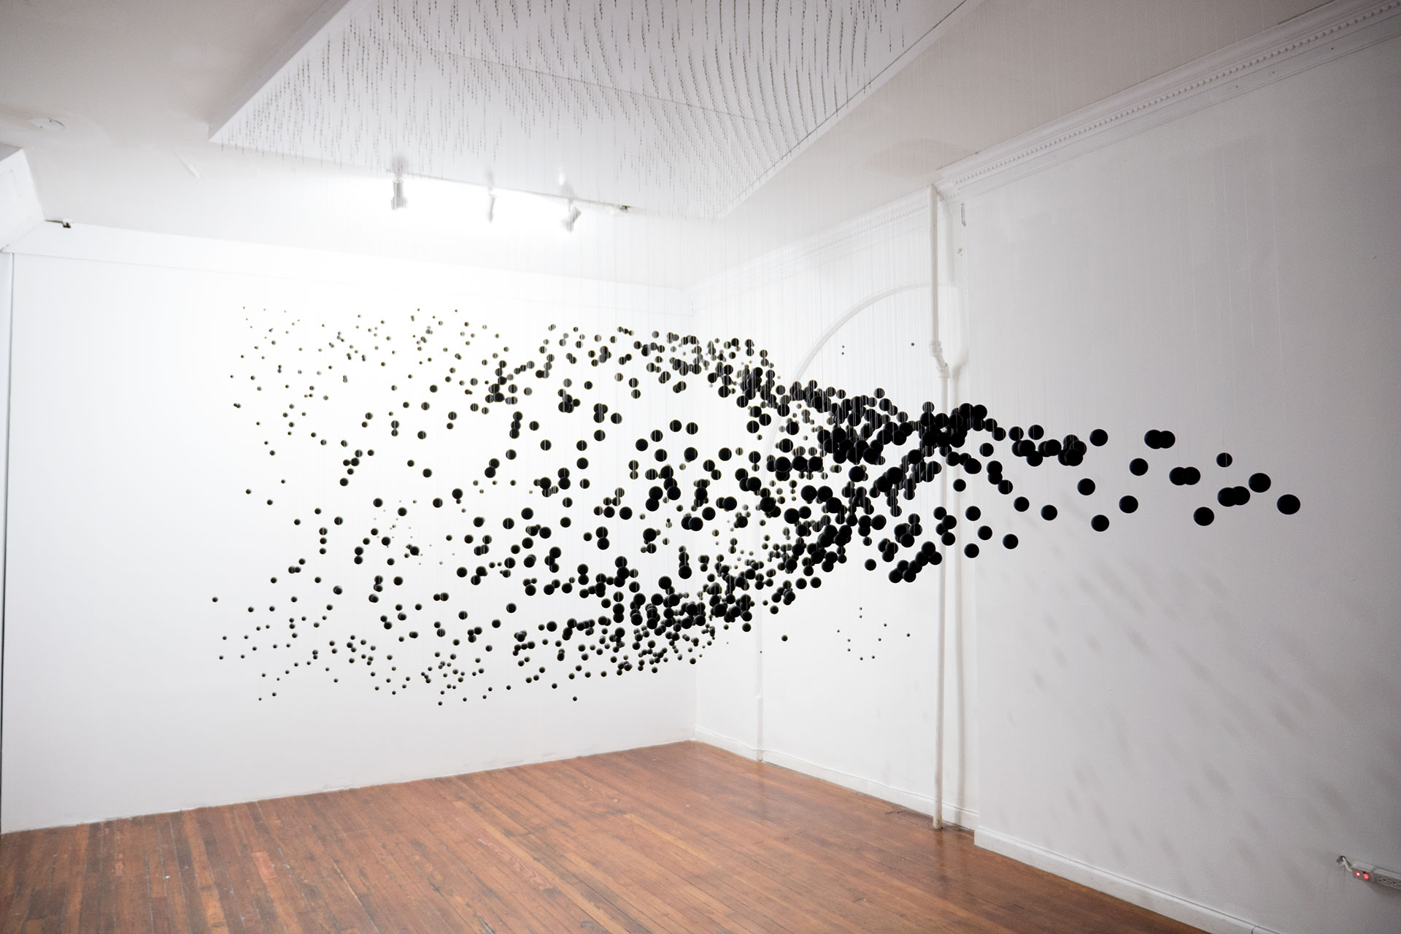
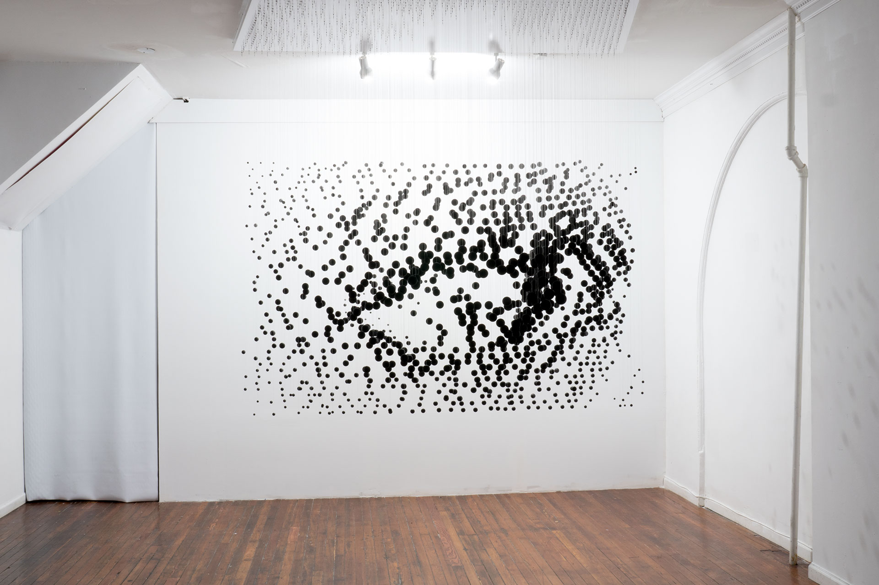
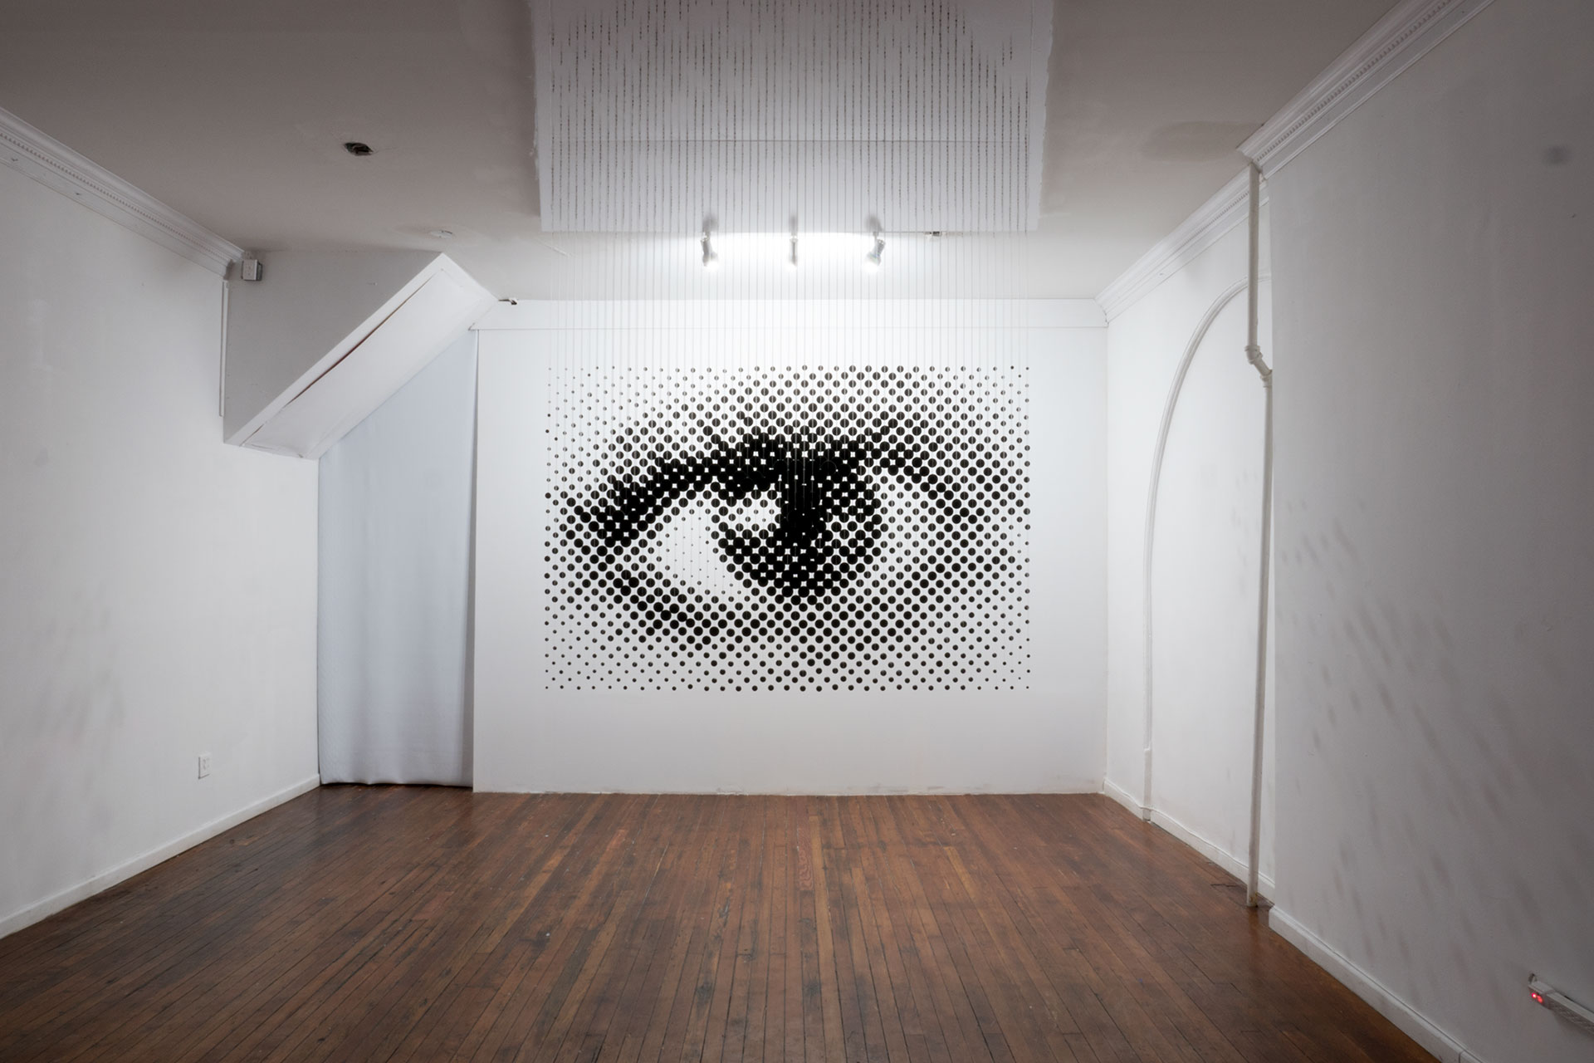
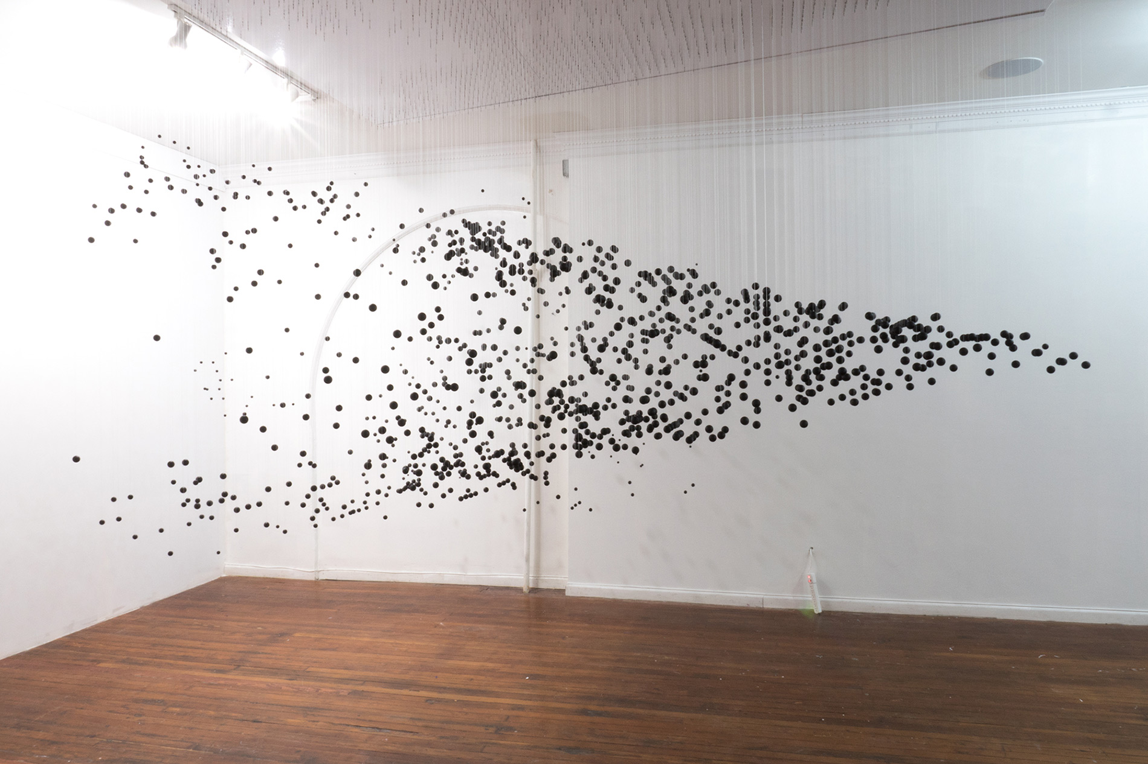
Cosmological distances
Measurement of distances to objects in the Universe is difficult
How can we measure these distances?
Why do we measure these distances?
Credit: Michael Murphy
https://www.perceptualart.com/portfolio.html

Slide 3
The SMHASH and CRRP programs
Spitzer Merger and Shape of the Galactic Halo (SMHASH)
Aims to construct 3D map of the Milky Way (MW) galaxy
Uses mid-infrared observations of RR Lyrae (RRL) variable stars in globular clusters and dwarf Spheroidal galaxies (dSphs) of the MW
Carnegie RR Lyrae Program (CRRP)
Aims to study RR Lyrae in the MW galaxy
Together these programs are reliant on accurate distance measurements

Slide 4
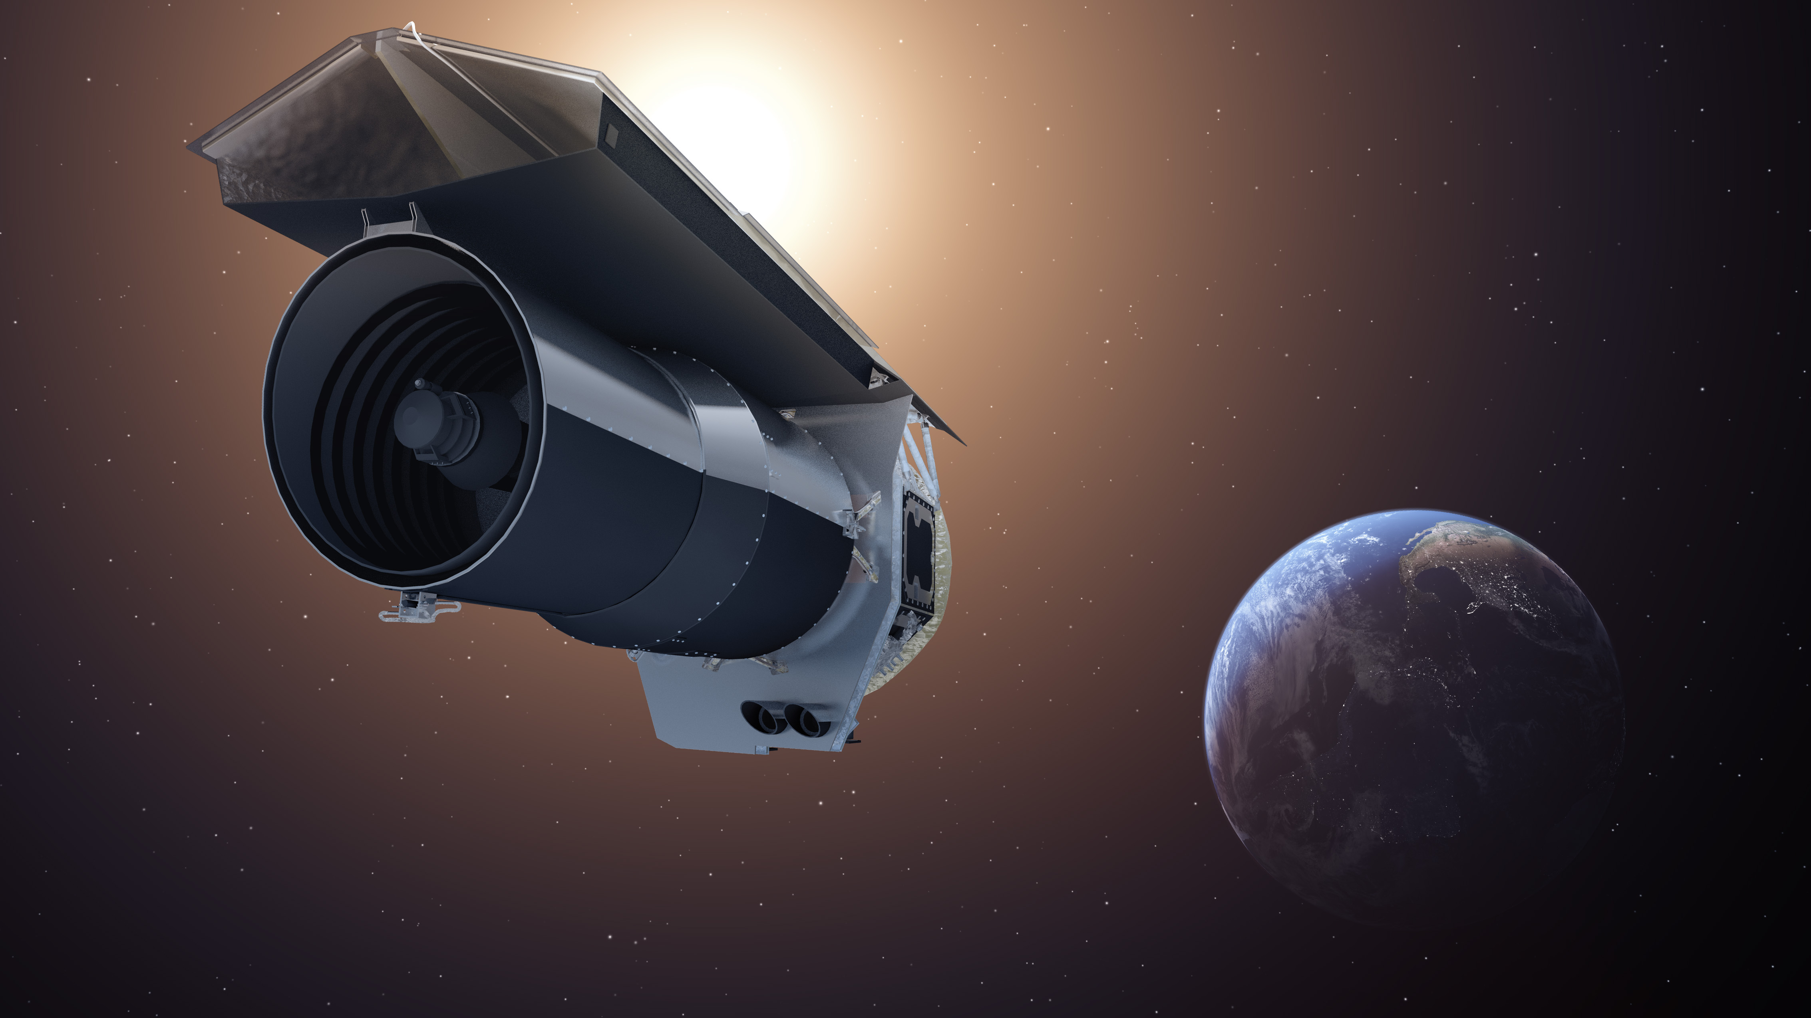
The Spitzer Space Telescope
The mission launched on the 25 August 2003 and was retired on the 30 January 2020
Infrared Array Camera (IRAC) which could take images in the 3.6 μm, 4.5 μm, 5.8 μm and 8 μm wavebands
In 2009 Spitzer’s cryogen run out, resulting in only the 3.6 μm and 4.5 μm waveband cameras working, marking the start of the Spitzer Warm Mission
First directly captured light from exoplanets
Spitzer Space Telescope (Artist’s Impression)
Credit: NASA/JPL-Caltech

Slide 5
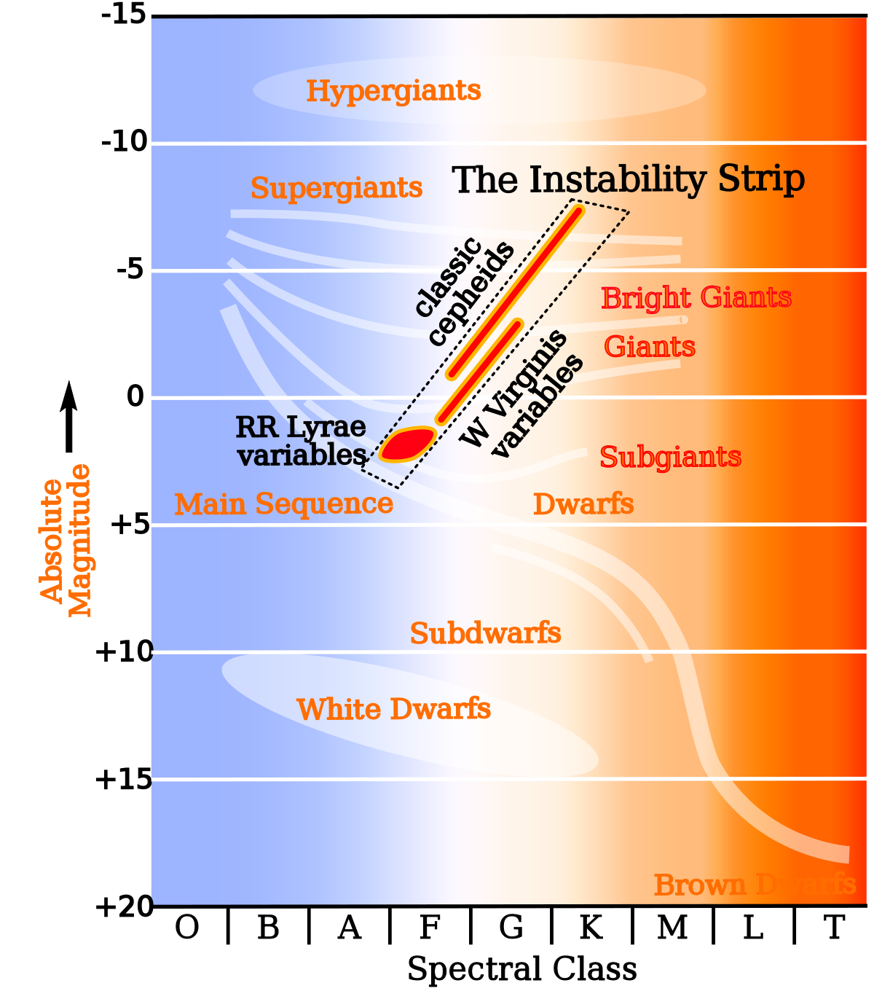
RR Lyrae variable stars
RR Lyrae (RRL) are Population II stars:
Relatively old (> 10 billion years)
Low overall metallicity (metal poor)
Luminosity varies with periods of around a few hours to a day
Typically less massive than the Sun (0.5 - 0.8 solar masses)
Abundant in globular clusters residing in the MW galaxy
Lie on the instability strip of HR diagram
Used as standard candles
Source: https://commons.wikimedia.org/wiki/File:HR-diag-instability-strip.svg

Slide 6
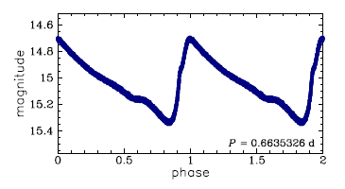
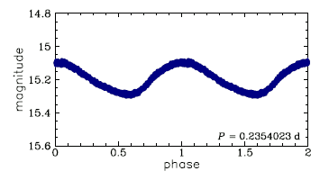
Types of RR Lyrae
RRab:
Pulsate in the fundamental frequency
Typically larger amplitudes and longer periods
RRc:
Pulsate in the first overtone
Typically smaller amplitudes and shorter periods
More sinusoidal and symmetrical
RRd:
Pulsate in both fundamental frequency and first overtone simultaneously
Top: RRab
Bottom: RRc
Credit: Soszynski & OGLE Team

Slide 7
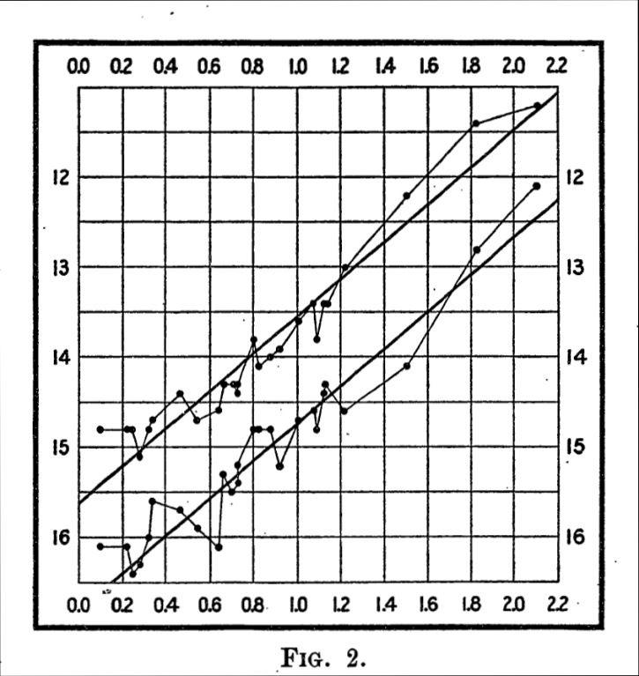
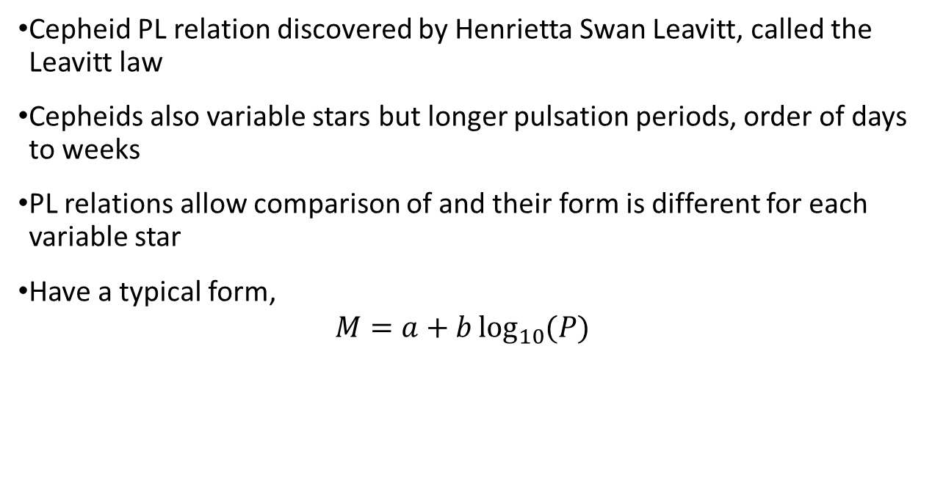


Cepheids and the Period-Luminosity relation
Cepheid PL relation discovered by Henrietta Swan Leavitt, called the Leavitt law
Cepheids also variable stars but longer pulsation periods, order of days to weeks
PL relations allow comparison of and their form is different for each variable star
Have a typical form,
$$M=a+b\log_{10}{(P)}$$
$$absolute magnitude$$
[1] Leavitt H S and Pickering E C 1912 Harvard College Observatory Circular 173 1-3
$$\log_{10}{P}$$

Slide 8
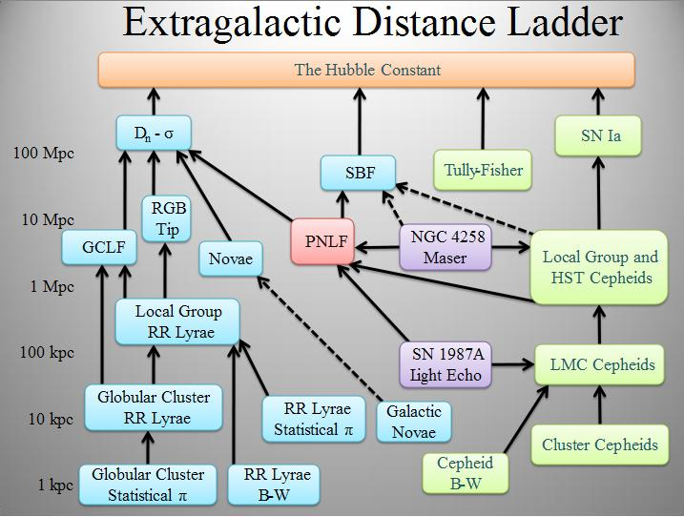
Cosmic distance ladder
Used to calibrate distances from the Milky Way galaxy (10 kpc), through the local group (1 Mpc) and beyond
Ultimate aim of accurately measuring the Hubble constant
Cepheid route previously used to climb the ladder
An independent route using RRLs can be climbed to obtain more accurate values for the Hubble constant
Each rung provides information that can be used to progress to the next rung
[1] Ciardullo R 2004, eprint arXiv:astro-ph/0407290
https://commons.wikimedia.org/wiki/File:Extragalactic_distance_ladder.jpg

Slide 9
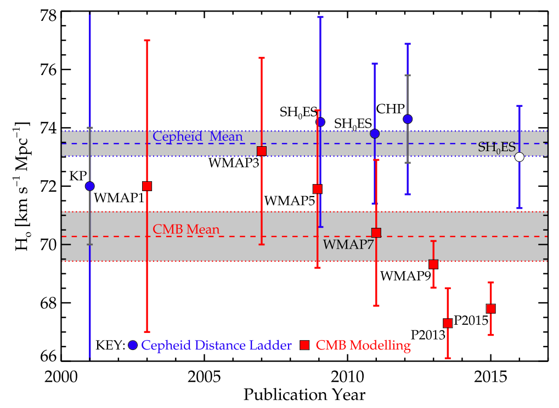
The Hubble Constant
Fundamental disagreement in values depending on method:
Classical Cepheids: 73.5 kms⁻¹Mpc⁻¹
CMB: 70.5 kms⁻¹Mpc⁻¹
RR Lyrae variables could prove a useful route up the cosmic distance ladder
Obtain more accurate values for the Hubble constant to resolve this inconsistency
Far reaching implications on our understanding of the Universe
[1] Beaton et al 2016 The Astrophysical Journal 832 210

Slide 10
Data selection
IRAC on board Spitzer observed regions of around 6×15 arcminutes around the centre of globular clusters
Analysed Pal 5 and Pal 13 only, with data for both in the 3.6 μm (channel 1) and 4.5 μm (channel 2) wavebands
12 epochs of data taken over at least one full cycle for the longest period RRL in the cluster
Raw data pre-processed into basic calibrated data (BCD) frames to reduce images
Mosaic frames of each epoch in each channel created by project supervisor to create the final data to be analysed

Slide 11
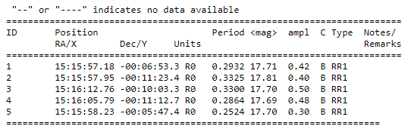
RR Lyrae catalogues
Positions (in RA and Dec) and periods of known RRLs obtained from star catalogues
Catalogue of Variable Stars in Galactic Globular Clusters maintained by Christine Clement
Region search in Gaia of stars flagged as variable in 10’ radius around the clusters to identify any extra RRLs within the epoch frames
140784 RRLs in Gaia Data Release 2 (DR2) searched and matched using source_ids from the region search to obtain more up to date periods as well as RRL type
Example of the Catalogue of RRLs in Pal 5:
Note- Periods in days and RR1 type RRLs designated here correspond to RRc type RRLs
Credit: Christine Clement

Slide 12
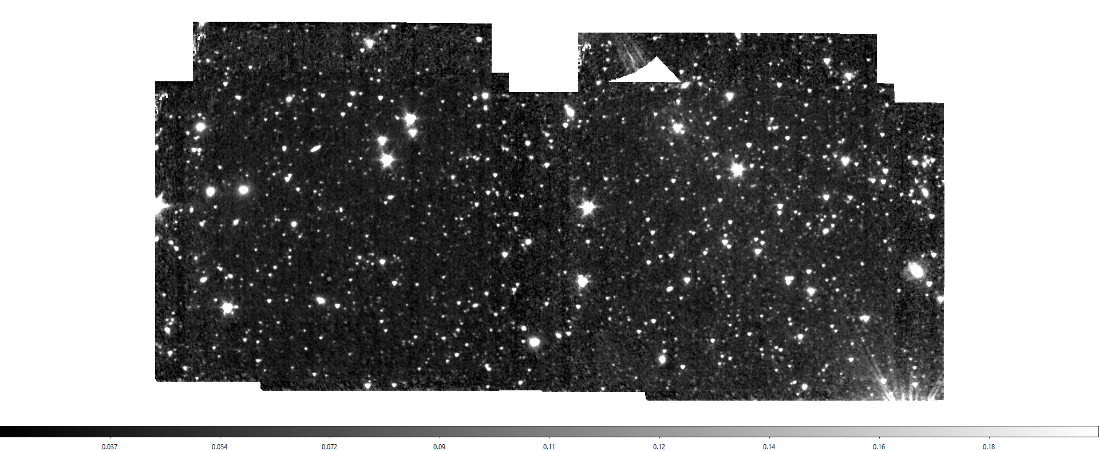
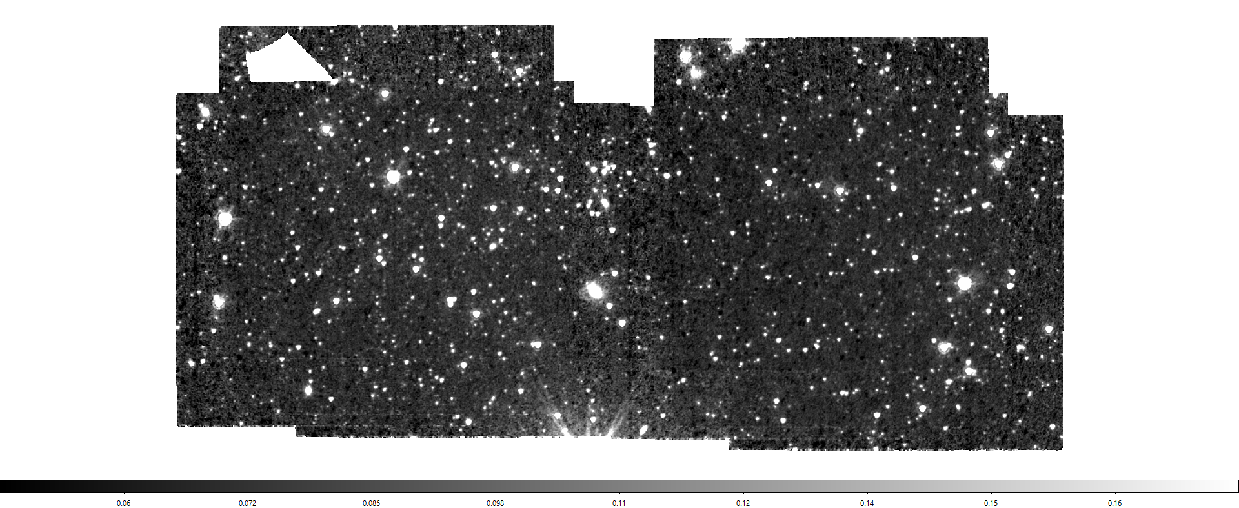
Master mosaic frames (Palomar 5)
Channel 1 (3.6 μm)
Channel 2 (4.5 μm)
Example of both channel 1 and channel 2 master mosaic frames (aligned, channel 1 overlaying channel 2)

Slide 13
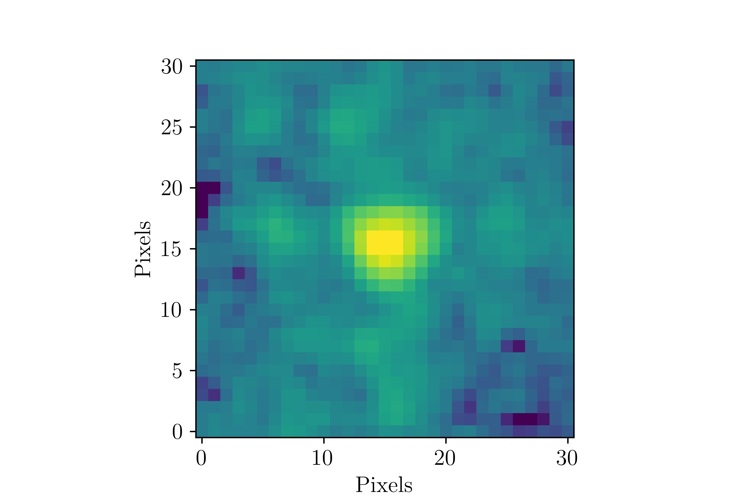
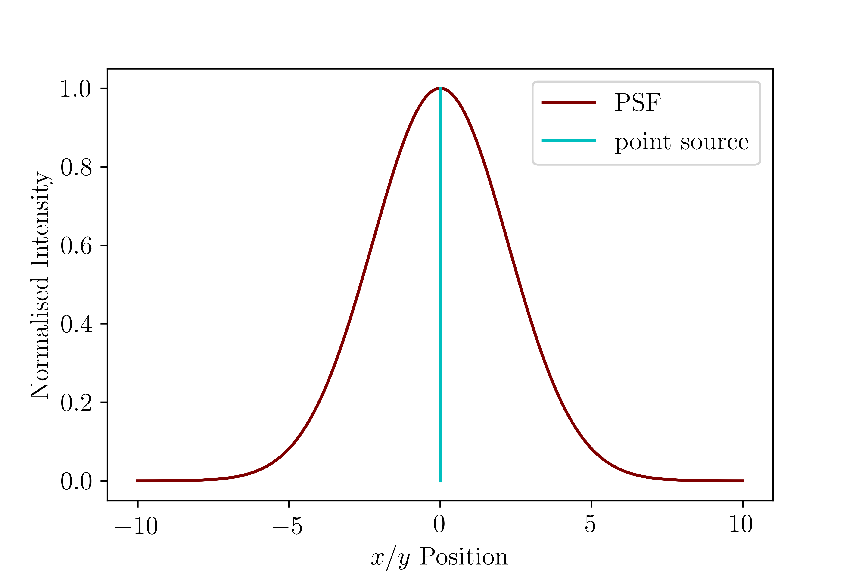
Photometry
Two main methods considered:
1. Aperture photometry
2. PSF photometry
Measuring flux through an aperture of known radius
Subtract background from an annulus around star
Construct a point spread function of the point sources in the frame
Fit PSF model to the sources to measure their flux values

Slide 14
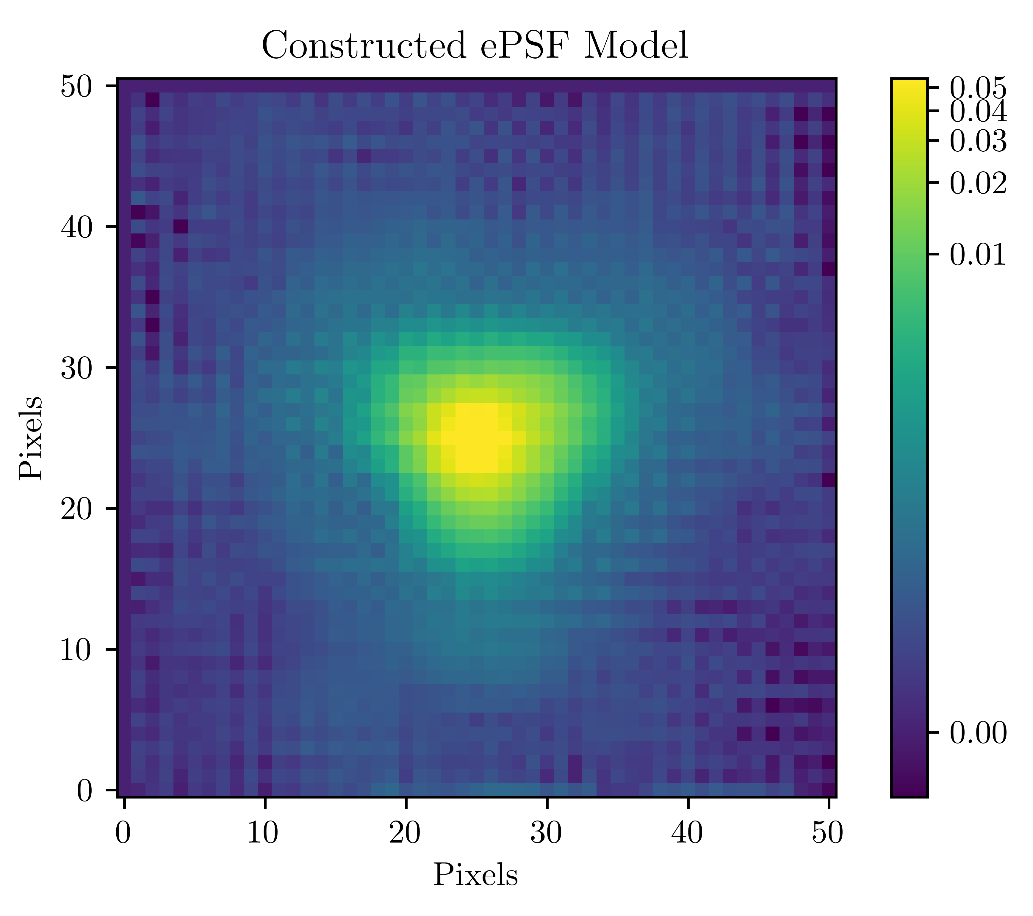
PSF models
Start
Master mosaic image
Run source detection algorithm
Build PSF model from star sample
Examine candidate PSF stars
No
Remove defective stars from list
Satisfactory PSF model?
PSF model generated
Yes

Slide 15
Performing photometry
Start
Epoch frame
Advance to next epoch (terminate after 12 epochs)
Join to master source list
Run source detection algorithm
Next iteration required?
Calculate apparent magnitudes
Match stars via coordinates to master source list
Yes
No
Fit PSF model to detected stars
Obtain flux values
Subtract detected stars from image (residual image)

Slide 16
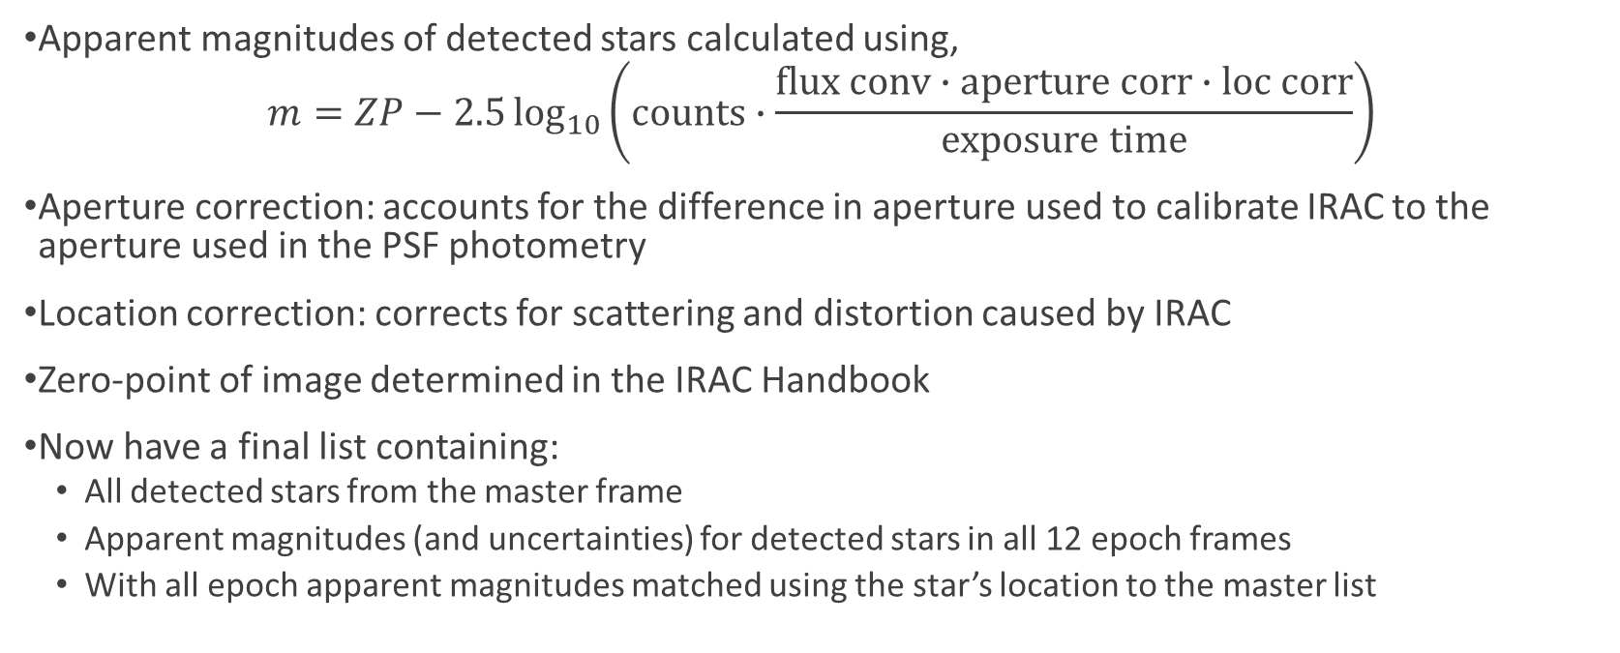
Apparent magnitudes
Apparent magnitudes of detected stars calculated using,
$$m=ZP−2.5\log_{10}\left(counts∙\frac{flux conv∙aperture corr∙loc corr}{exposure time}\right)$$
Aperture correction: accounts for the difference in aperture used to calibrate IRAC to the aperture used in the PSF photometry
Location correction: corrects for scattering and distortion caused by IRAC
Zero-point of image determined in the IRAC Handbook
Now have a final list containing:
All detected stars from the master frame
Apparent magnitudes (and uncertainties) for detected stars in all 12 epoch frames
With all epoch apparent magnitudes matched using the star’s location to the master list

Slide 17
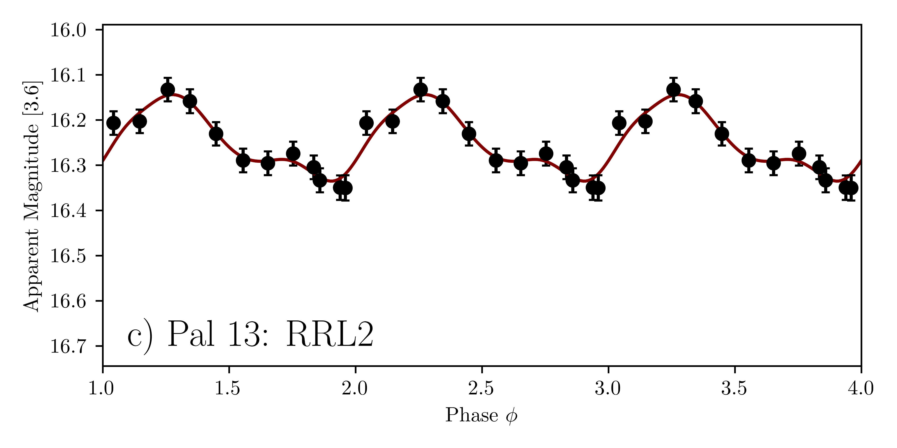
Light curves
Known RRLs were extracted from the final list using the RRL catalogues
Light curves are used to examine how the brightness of a star varies as a function of time
Phase was calculated in order to check if periods join together smoothly
Curve fit using a Gaussian local estimation algorithm (GLOESS)
GLOESS calculated the time-averaged apparent magnitude of each detected RRL and its uncertainty
Uncertainties calculated using the uncertainty of each individual epoch magnitude, the uncertainty in the fit and the dust extinction value (in mag) for the star
Period = 0.5971 days

Slide 18
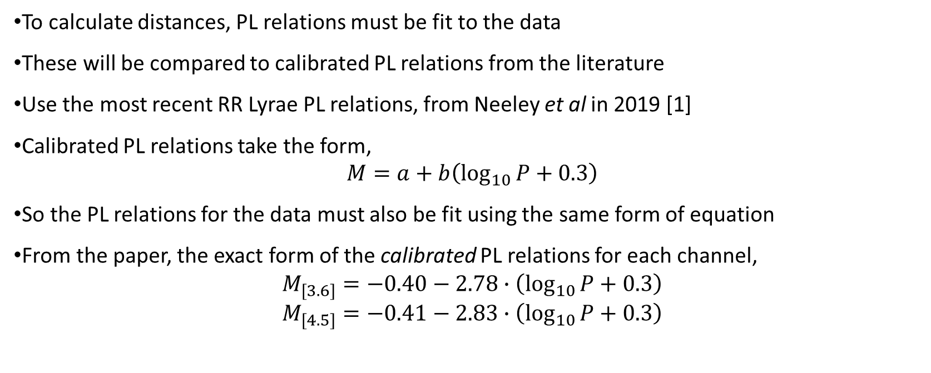
Fitting PL relations
To calculate distances, PL relations must be fit to the data
These will be compared to calibrated PL relations from the literature
Use the most recent RR Lyrae PL relations, from Neeley et al in 2019 [1]
Calibrated PL relations take the form,
$$M=a+b\left(\log_{10}{P}+0.3\right)$$
So the PL relations for the data must also be fit using the same form of equation
From the paper, the exact form of the calibrated PL relations for each channel,
$$M_{[3.6]}=−0.40−2.78∙\left(\log_{10}{P}+0.3\right)$$
$$M_{[4.5]}=−0.41−2.83∙\left(\log_{10}{P}+0.3\right)$$
[1] Neeley J R et al. 2019 MNRAS 490 4254-4270

Slide 19
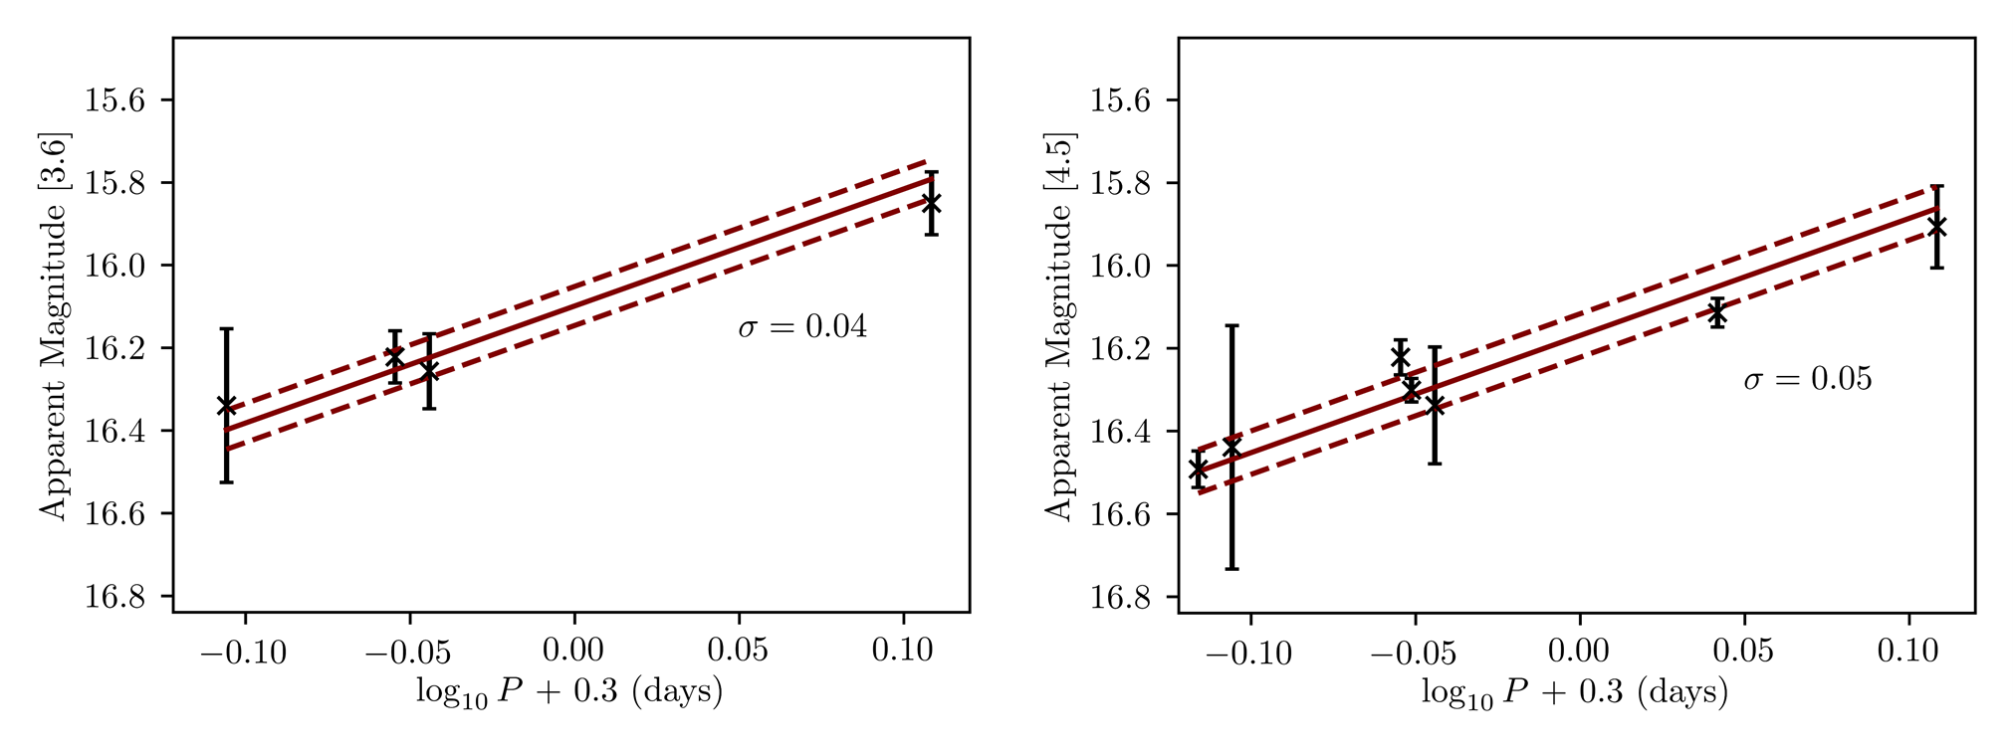
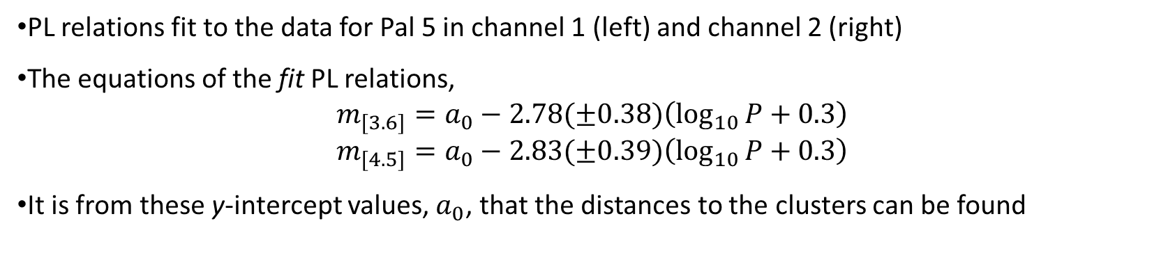
PL relations fit to the data for Pal 5 in channel 1 (left) and channel 2 (right)
The equations of the fit PL relations,
$$m_{[3.6]}=a_{0}−2.78(±0.38)\left(\log_{10}{P}+0.3\right)$$
$$m_{[4.5]}=a_{0}−2.83(±0.39)\left(\log_{10}{P}+0.3\right)$$
It is from these y-intercept values, $a_{0}$, that the distances to the clusters can be found

Slide 20
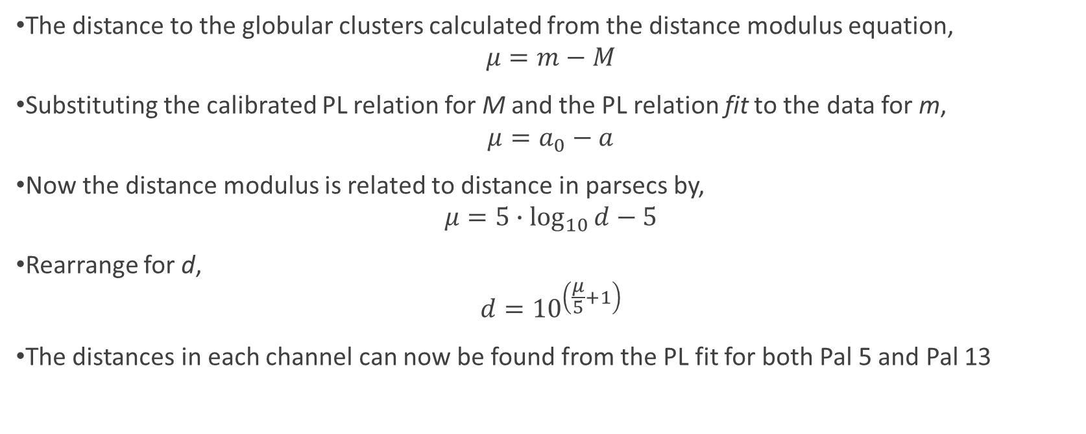
Distance calculations
The distance to the globular clusters calculated from the distance modulus equation,
$$μ=m−M$$
Substituting the calibrated PL relation for M and the PL relation fit to the data for m,
$$μ=a_{0}−a$$
Now the distance modulus is related to distance in parsecs by,
$$μ=5∙\log_{10}{d}−5$$
Rearrange for d,
$$d={10}^{\left(\frac{μ}{5}+1\right)}$$
The distances in each channel can now be found from the PL fit for both Pal 5 and Pal 13

Slide 21
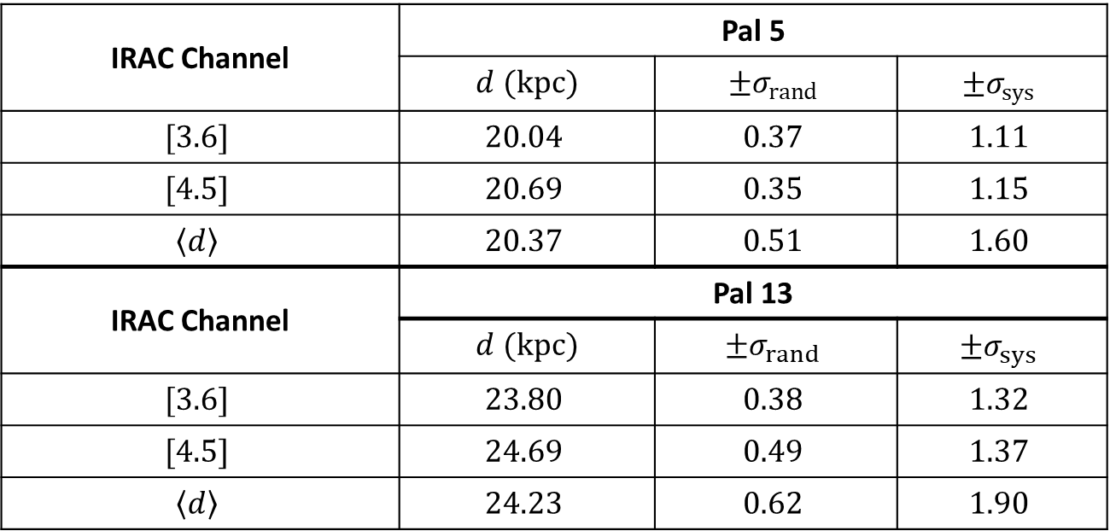
Results
IRAC Channel | Pal 5
 | $d$ $(kpc)$ | $$±σ_{rand}$$ | $$±σ_{sys}$$
$$[3.6]$$ | $$20.04$$ | $$0.37$$ | $$1.11$$
$$[4.5]$$ | $$20.69$$ | $$0.35$$ | $$1.15$$
$$\left\langle d\right\rangle$$ | $$20.37$$ | $$0.51$$ | $$1.60$$
IRAC Channel | Pal 13
 | $d$ $(kpc)$ | $$±σ_{rand}$$ | $$±σ_{sys}$$
$$[3.6]$$ | $$23.80$$ | $$0.38$$ | $$1.32$$
$$[4.5]$$ | $$24.69$$ | $$0.49$$ | $$1.37$$
$$\left\langle d\right\rangle$$ | $$24.23$$ | $$0.62$$ | $$1.90$$

Slide 22
Comparison of results to the literature
The distances calculated were compared to previous determinations
Pal 5
Price-Whelan et al in 2019 obtained 20.6 ± 0.36 (± 1.13) kpc
Küpper et al in 2015 obtained 23.6 ± 0.7 kpc
Inconsistent with the results obtained in this project
Pal 13
Côté et al in 2002 obtained 24.3 ± 1.1 kpc
Shipp et al in 2020 obtained 23.6 ± 0.2 kpc

Slide 23
Distance measurement uncertainties
Random sources of uncertainty (first quoted error):
Caused by least-squares fitting of the y-intercept of the PL fit
Uncertainty in the y-intercept of the calibrated PL relation
Ultimately based on the apparent magnitudes and so photometric uncertainties can be considered
Systematic sources of uncertainty (second quoted error):
Predominantly by the uncertainty in the gradient of the calibrated PL relation
Small component is again caused by the y-intercept of the calibrated PL relation

Slide 24
Analysis of the distances
Uncertainty in distance measurements for Pal 5 and Pal 13 are both around 7%
Higher than the anticipated 1-2% in the SMHASH program
Systematic uncertainties account for around 75% of the overall uncertainty
This is due to the large uncertainties in the gradients given in the PL relation paper
PL relations in the paper were calibrated using parallax data for RR Lyrae stars in Gaia
Improvements in systematic uncertainty is required to meet the SMHASH aims
Uncertainties can also be improved by considering metallicity of RRLs in the clusters
This would involve using a Period-Luminosity-Metallicity (PLZ) relation
Has the possibility to reduce uncertainties by a further 1% according to Neeley et al (2019)

Slide 25
Looking toward the future
Future work to be undertaken:
Apply the work to more globular clusters, such as IC4499
Consider metallicities
Improvements in Gaia parallax values could reduce uncertainty in the PL relations
This would decrease the “error budget” available for determining the Hubble constant
Uncertainties of less than 2% could be achieved for the Hubble constant
This work has implications therefore on our understanding of the age, size and expansion of the Universe from the accurate calculation of the Hubble constant and resolving the present inconsistencies

